Slide 1
Matlab程式設計_4_20
助教:金郁善

Slide 2
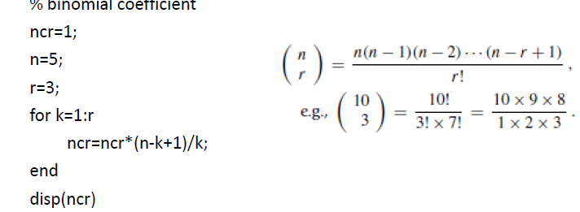
For loop

Slide 3
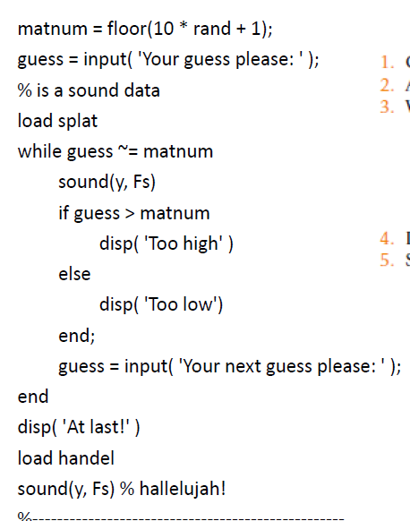
While loop
main.m

Slide 4
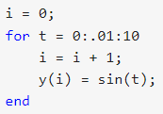

Vectorization
Advantages:
Appearance: Vectorized mathematical code appears more like the mathematical expressions found in textbooks, making the code easier to understand.
Less Error Prone: Without loops, vectorized code is often shorter. Fewer lines of code mean fewer opportunities to introduce programming errors.
Performance: Vectorized code often runs much faster than the corresponding code containing loops.

Slide 5
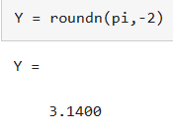
roundn(X,n)

Slide 6
HOMEWORK

Slide 7
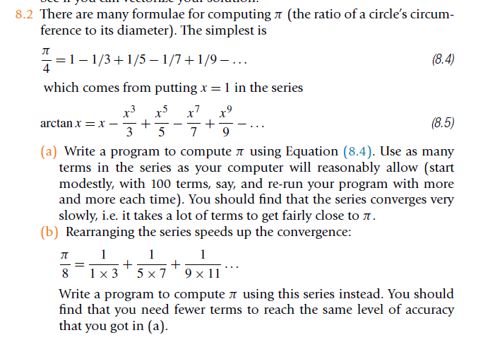

Slide 8
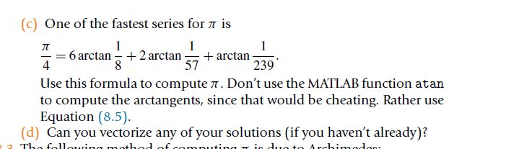

Slide 9
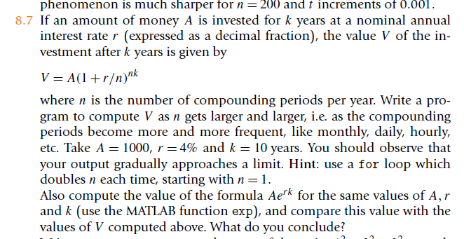

Slide 10


Slide 11
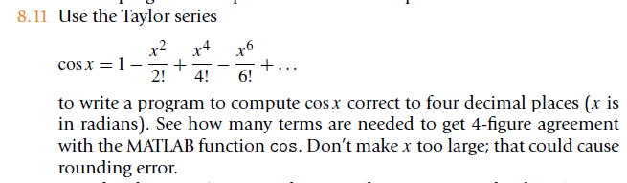

Slide 12
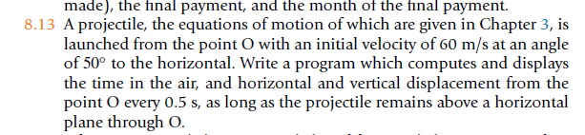

Slide 13
